Slide 1

WEB DASHBOARDS
Session II

Slide 2
1. User Association to the Dashboards. 2. Dashboard Common Controls
TABLE OF CONTENTS

Slide 3
User Association to the Dashboards
Steps to associate Dashboard to User & Group.
Go to PO Application Company Settings.
Go to Roles Settings & Edit the required group where user belongs. Say – “Global Administrator”
Go to Role Configurations then Analytics & Select Your Dashboard Name from the Dashboard Selection Drop Down list. Say – “EXE – Standard Layouts”
Provide Permissions & Save your Changes.
Now Go back to Company Settings.
Then Go to User Settings.
Create new or Edit any existing user. Say – Admin@USRENALCARE.com

Slide 4
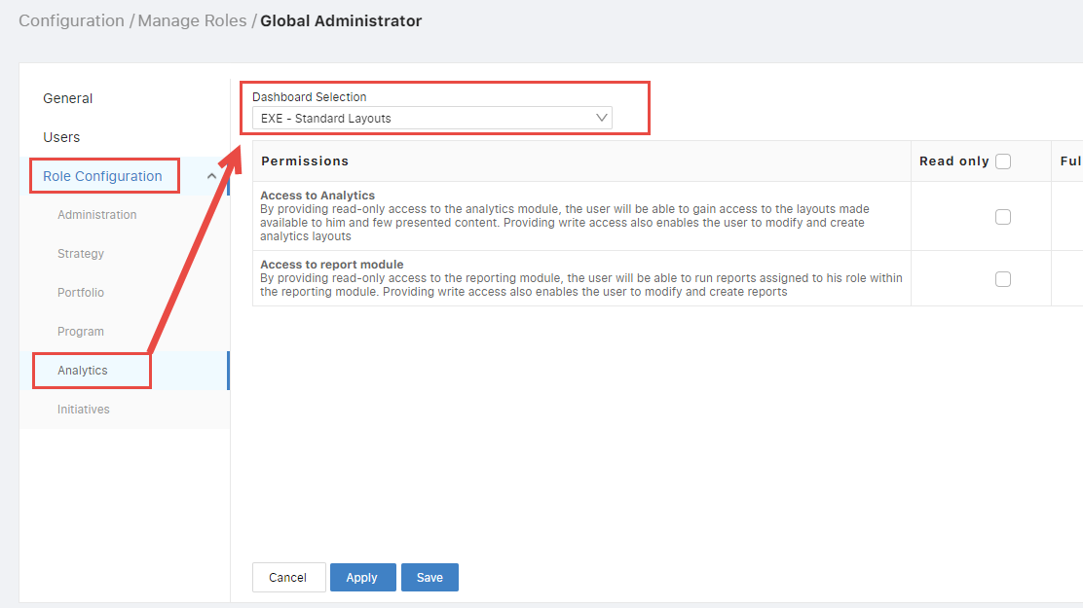
User Association to the Dashboards

Slide 5
User Association to the Dashboards
Bind the user with COS from COS Binding & apply your changes.
Go to Company organization structure, here click on the available node. Now You can see the available Roles.
Check your Role “Global Administrator” where you associated your dashboard “EXE – Standard Layouts”.
Apply & Save your Changes.
Again, Go to company Settings then Dashboards Settings.
Edit Association of your Dashboard “EXE – Standard Layouts”.
Drag the User Group from available list to Selected Groups.
Then Save the changes.

Slide 6
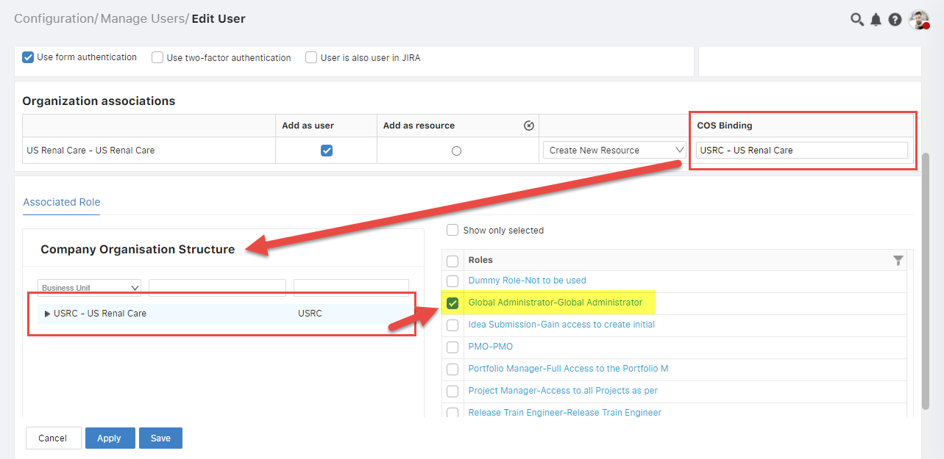
User Association to the Dashboards
Organization

Slide 7
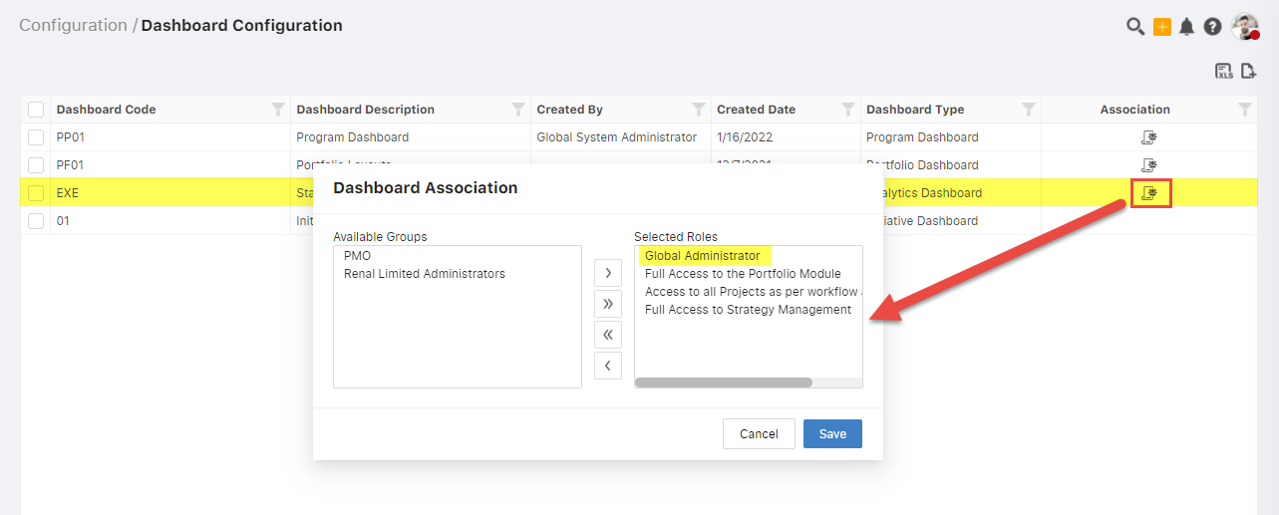
User Association to the Dashboards

Slide 8
User Association to the Dashboards
Now Global Administrator user can see all the layouts available in “EXE – Standard Layouts” Dashboard.
Note :
Single Dashboard can only be associated one Role at a time.
For Multiple Dashboard Association to Single user, Multiple Roles having different Dashboards Should be associated to user from User Settings.

Slide 9
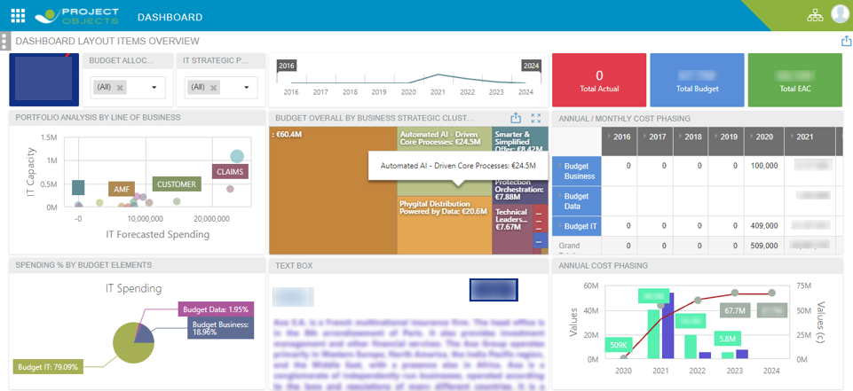
Dashboard Common Controls
Let's Build a Layout using the Common controls as shown in the above picture.

Slide 10
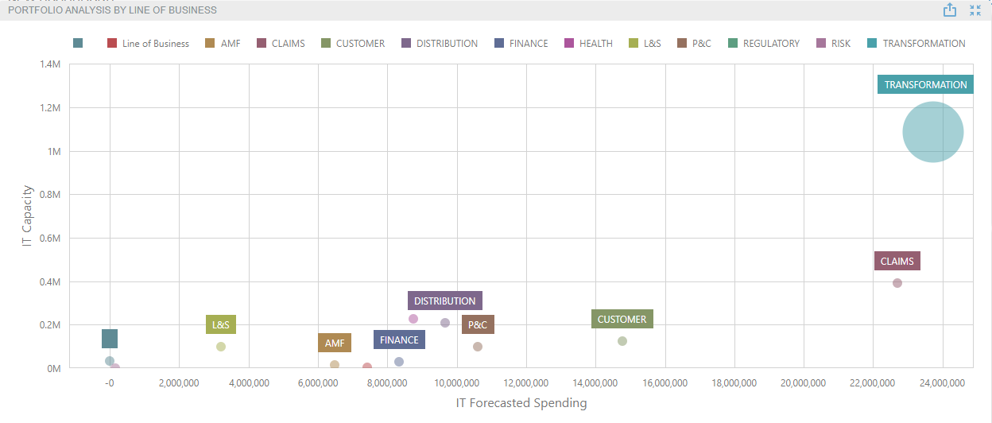
SCATTER CHART
Caption : Portfolio Analysis By Line of Business
Data Source : Portfolio register
X-Axis : IT Forecasted Spending (Portfolio Forecast Costs)
Y-Axis : IT Capacity (Portfolio Forecast Work)
Weight : IT Actual Spending (Portfolio Actual Costs)
Argument : Line of Business

Slide 11
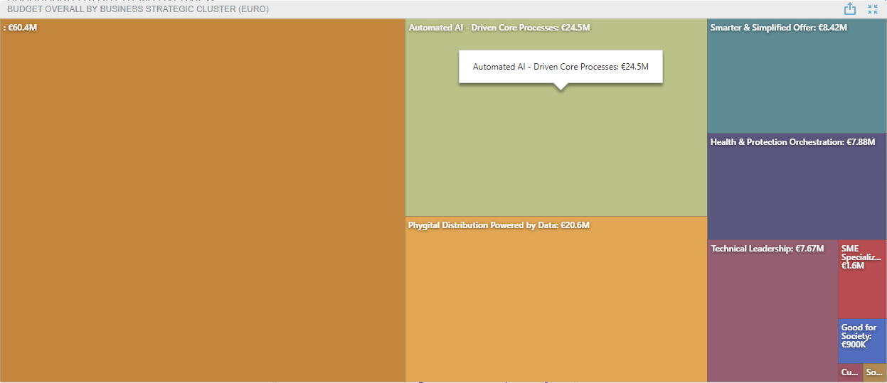
TREEMAP
Caption : Budget Overall By Business Strategic Cluster (EURO)
Data Source : Portfolio register
Values : IT Budget Spending (Portfolio Baseline Costs)
Argument : Business Strategic Cluster

Slide 12
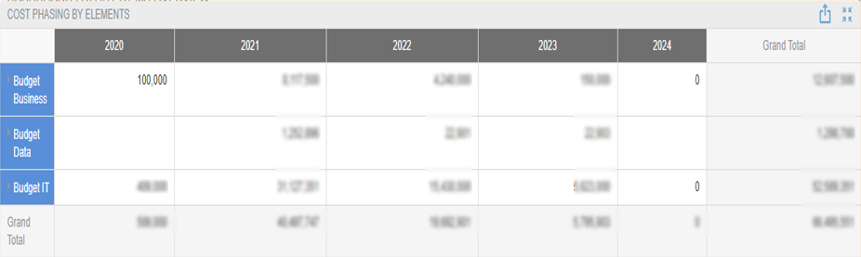
PIVOT TABLE
Caption : Cost Phasing by Elements
Data Source : Project Basic Cost Monthly Phasing
Values : EAC (sum)
Columns : Year
Rows : Element Name | Title
Filter : Element Type is Cost

Slide 13
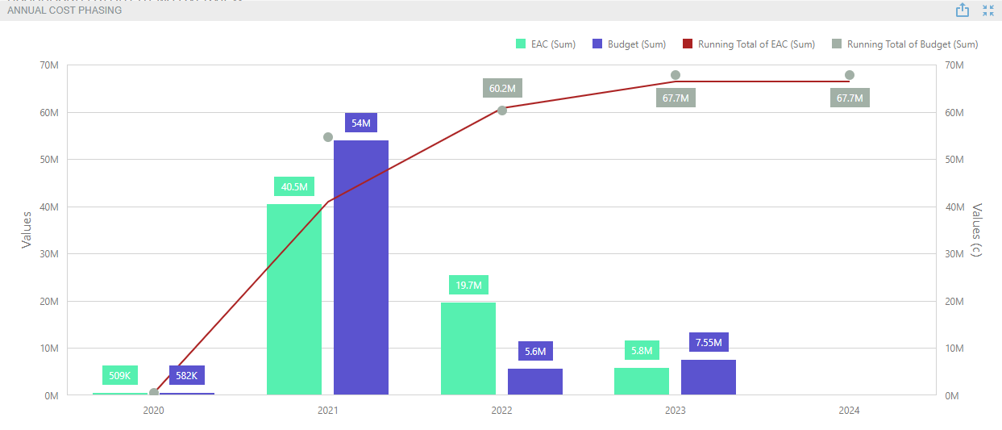
BAR CHART
Caption : Annual Cost Phasing
Data Source : Project Basic Cost Monthly Phasing
Values : EAC | Budget | EAC (c) | Budget (c)
Arguments : Year

Slide 14
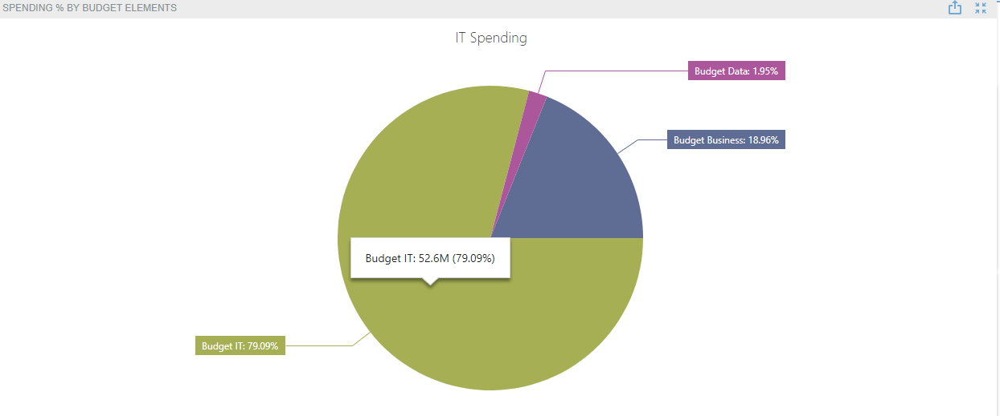
PIE CHART
Caption : Spending % By Budget Elements
Data Source : Project Basic Cost Monthly Phasing
Values : IT Spending (EAC)
Arguments : Element Name | Project Category
Filter : Element Type is Cost

Slide 15
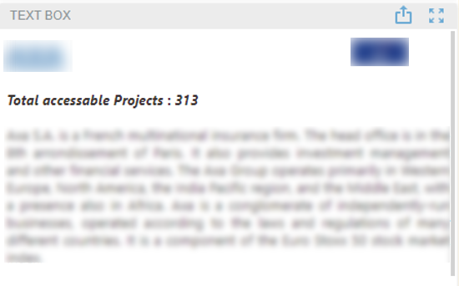
TEXT BOX
The Text Box dashboard item is used to display rich text within a dashboard.
Features used in image shown:
Hyperlink
Logo Image
Project Count
Description

Slide 16
Thank You.

